Slide 1
Vaccinated susceptibles are able to get infected
Parameter | Description
r_{x} | Rate of Vaccination in subpopulation x
β_{xy} | Per capita rate of transmission from infectious subpopulation y to susceptible subpopulation x
γ | Per capita rate of recovery
σ₁ | Per capita rate of immunity loss (vaccinated individuals)
σ₂ | Per capita rate of immunity loss (from natural infection)
σ₃ | Per capita rate of immunity loss (for those who have been infected/recovered and vaccinated)
e_{ff1} | Vaccine Efficacy (preventing infection)
e_{ff2} | Vaccine Efficacy (preventing onwards infectiousness)
V_{i}
β_{xx}
Vi_{i}
γ
Vr_{i}
σ₃
σ₁
r_{i} · (S_{i} /(S_{i}+I_{i}+R_{i}))
β_{xx}
S_{i}
I_{i}
γ
R_{i}
Example sub-population i
σ₂
r_{i} · (I_{i}/(S_{i}+I_{i}+R_{i}))
Compartment | Description (Proportion of population in…)
S_{x} | Susceptibles in subpopulation x
I_{x} | Infectious individuals in subpopulation x
R_{x} | Recovered individuals in subpopulation x
Rv_{x} | Recovered or Infectious and subsequently vaccinated in subpopulation x
V_{x} | Vaccinated individuals in subpopulation x
Vi_{x} | Vaccinated and infectious individuals in subpopulation x
Vr_{x} | Vaccinated and recovered individuals in subpopulation x
Rv_{i}
σ₃
r_{i} · (R_{i}/(S_{i}+I_{i}+R_{i}))
Example Transmission Route – Infection from subpop j to i
To/From
Susceptible (S_{i})
Vaccinated (V_{i})
β_{ij}I_{j}S_{i}
(1-e_{ff1})β_{ij}I_{j}V_{i}
Infected (I_{j})
S_{i}
I_{i}
V_{i}
Vi_{i}
Vaccination Rate (r_{i})
We model the vaccination rate as a function of the:
Total fraction of individuals in S, I and R compartments (available to vaccinated) at the start of the vaccination period multiplied by the proportion divided by the duration of the vaccination period for the specific subgroup.
We assume that the rate of vaccination is constant (r_{i}*1), therefore the rate of vaccination in S, I and R compartments must be normalised to the total proportion of individuals in these three compartments.
Vaccinated but
Infected (Vi_{j})
(1-e_{ff2})β_{ij}Vi_{j}S_{i}
(1-e_{ff1})(1-e_{ff2})β_{ij}Vi_{j}V_{i}
S_{i}
I_{i}
V_{i}
Vi_{i}

Slide 2
Example equations sub-population i
$$\frac{dS_{i}}{dt}=σ1V_{i}+{σ2R}_{i}+σ3{(Rv}_{i}+{Vr}_{i}){−β}_{ii}S_{i}I_{i}−β_{ij}S_{i}I_{j}−β_{ik}S_{i}I_{k}−{\left(1−e_{ff2}\right)β}_{ii}S_{i}{Vi}_{i}−\left(1−e_{ff2}\right)β_{ij}S_{i}{Vi}_{j}−\left(1−e_{ff2}\right)β_{ik}S_{i}{Vi}_{k}−r_{i}\frac{S_{i}}{S_{i}+I_{i}\text{+ }R_{i} }$$
$$\frac{dI_{i}}{dt}=β_{ii}S_{i}I_{i}+β_{ij}S_{i}I_{j}+β_{ik}S_{i}I_{k}+{\left(1−e_{ff2}\right)β}_{ii}S_{i}{Vi}_{i}+\left(1−e_{ff2}\right)β_{ij}S_{i}{Vi}_{j}+\left(1−e_{ff2}\right)β_{ik}S_{i}{Vi}_{k}−γI_{i}−r_{i}\frac{I_{i}}{S_{i}+I_{i}\text{+ }R_{i} }$$
$$\frac{dR_{i}}{dt}=γI_{i}−r_{i}\frac{R_{i}}{S_{i}+I_{i}\text{+ }R_{i} }−σ_{2}R_{i}$$
$$\frac{d{Rv}_{i}}{dt}=r_{i}\frac{I_{i}+R_{i}}{S_{i}+I_{i}\text{+ }R_{i} }−σ_{3}{Rv}_{i}$$
$$\frac{dV_{i}}{dt}=r_{i}\frac{S_{i}}{S_{i}+I_{i}\text{+ }R_{i} }−{\left(1−e_{ff1}\right)β}_{ii}V_{i}I_{i}−{\left(1−e_{ff1}\right)β}_{ij}V_{i}I_{j}−{\left(1−e_{ff1}\right)β}_{ik}V_{i}I_{k}−\left(1−e_{ff1}\right) {\left(1−e_{ff2}\right)β}_{ii}V_{i}{Vi}_{i}−\left(1−e_{ff1}\right)\left(1−e_{ff2}\right)β_{ij}V_{i}{Vi}_{j}−\left(1−e_{ff1}\right)\left(1−e_{ff2}\right)β_{ik}V_{i}{Vi}_{k}−σ_{1}V_{i}$$
$$\frac{d{Vi}_{i}}{dt}={\left(1−e_{ff1}\right)β}_{ii}V_{i}I_{i}+{\left(1−e_{ff1}\right)β}_{ij}V_{i}I_{j}+{\left(1−e_{ff1}\right)β}_{ik}V_{i}I_{k}+\left(1−e_{ff1}\right) {\left(1−e_{ff2}\right)β}_{ii}V_{i}{Vi}_{i}+\left(1−e_{ff1}\right)\left(1−e_{ff2}\right)β_{ij}V_{i}{Vi}_{j}+\left(1−e_{ff1}\right)\left(1−e_{ff2}\right)β_{ik}V_{i}{Vi}_{k}−γ{Vi}_{i}$$
$$\frac{d{Vr}_{i}}{dt}=γ{Vi}_{i}−σ_{3}{Vr}_{i}$$
Parameter | Description
r_{x} | Rate of Vaccination in subpopulation x
β_{xy} | Per capita rate of transmission from infectious subpopulation y to susceptible subpopulation x
γ | Per capita rate of recovery
σ₁ | Per capita rate of immunity loss (vaccinated individuals)
σ₂ | Per capita rate of immunity loss (from natural infection)
σ₃ | Per capita rate of immunity loss (for those who have been infected/recovered and vaccinated)
e_{ff1} | Vaccine Efficacy (preventing infection)
e_{ff2} | Vaccine Efficacy (preventing onwards infectiousness)
Compartment | Description (Proportion of population in…)
S_{x} | Susceptibles in subpopulation x
I_{x} | Infectious individuals in subpopulation x
R_{x} | Recovered individuals in subpopulation x
Rv_{x} | Recovered or Infectious and subsequently vaccinated in subpopulation x
V_{x} | Vaccinated individuals in subpopulation x
Vi_{x} | Vaccinated and infectious individuals in subpopulation x
Vr_{x} | Vaccinated and recovered individuals in subpopulation x

Slide 3
PARTIAL RELAXATION
R is only released from 1 to 1.8 (25% to the baseline R release of 4.2)

Slide 4
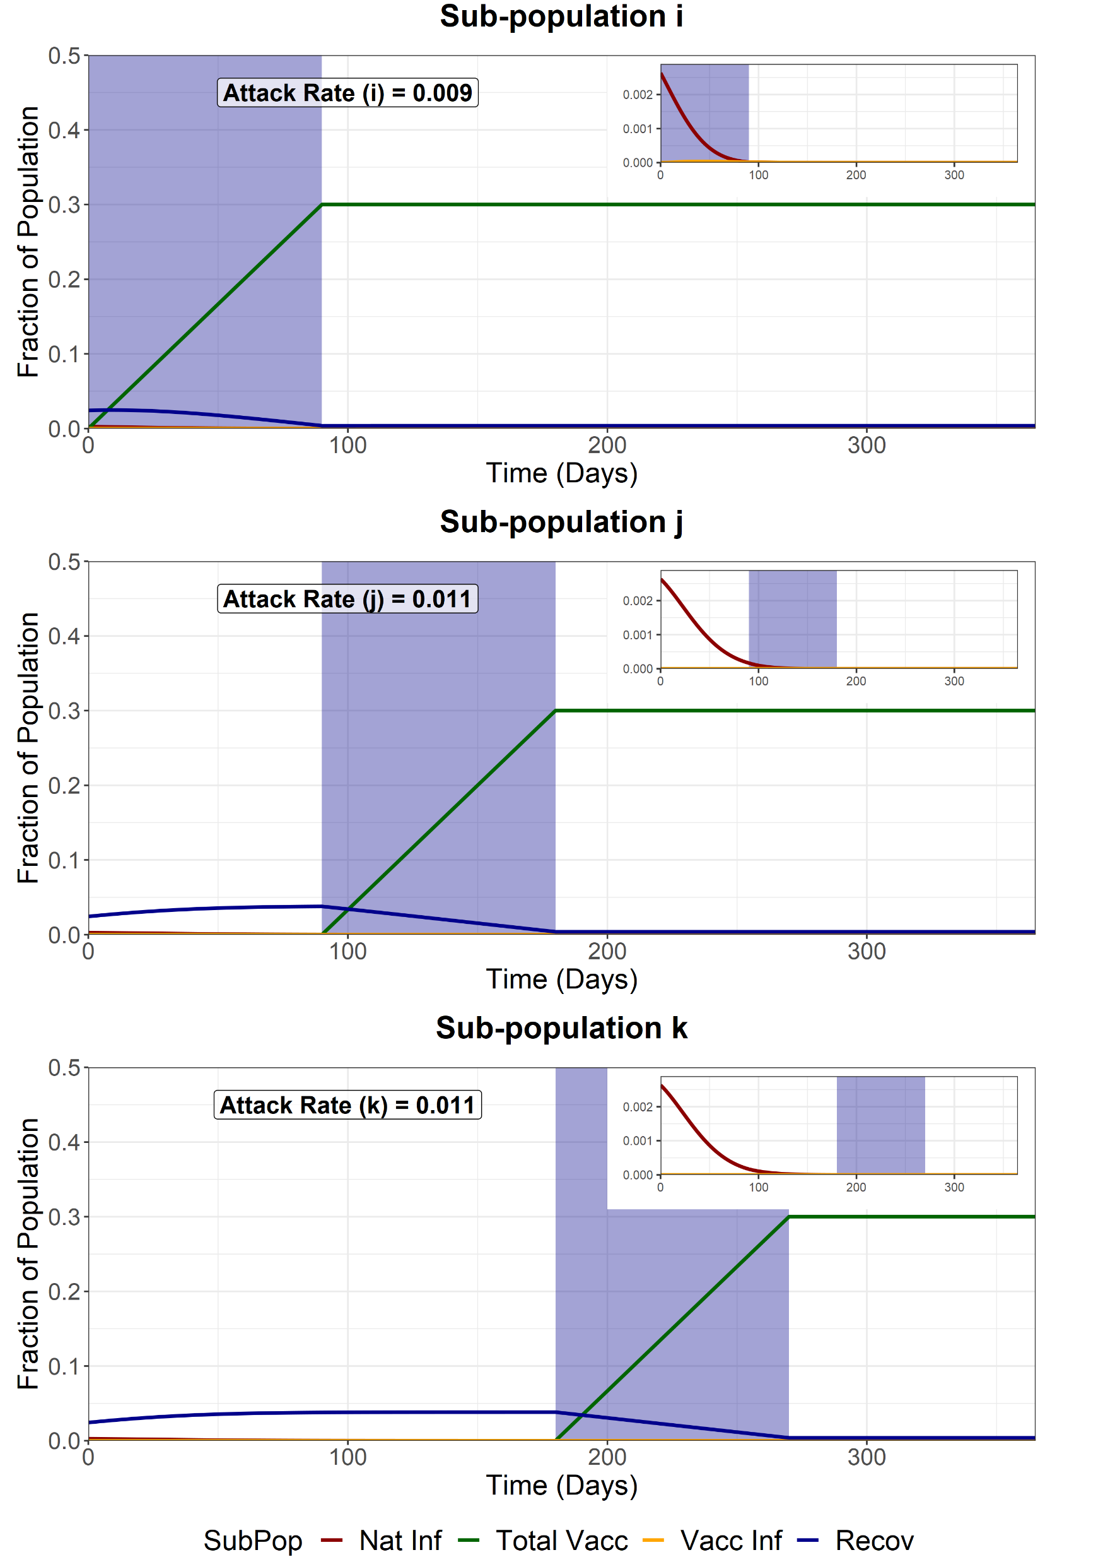
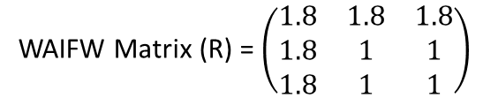
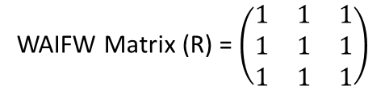
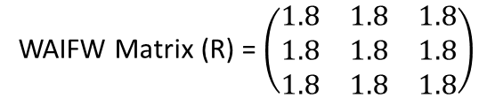
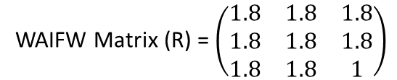
Sequential Vaccination
We model sequential vaccination of 3 sub-populations. Each vaccination schedule lasts 90 days and aims for 90% coverage of the available susceptibles, infecteds and recovereds at the beginning of the simulation. After vaccination of each subpopulation, the sub-population is released from NPIs, with the R increasing from 1 to 1.8. This is 25% between 1 and the baseline of 4.2, representing a weaker NPI release.
Attack Rate for fully susceptible individuals infected in sub-group i (no infections amongst those vaccinated) = 0.0082
WAIFW Matrix (R) = $\left(\begin{matrix}1 & 1 & 1 \\ 1 & 1 & 1 \\ 1 & 1 & 1\end{matrix}\right)$
During the pop i vaccination (t = 0-90)
WAIFW Matrix (R) = $\left(\begin{matrix}1.8 & 1.8 & 1.8 \\ 1.8 & 1 & 1 \\ 1.8 & 1 & 1\end{matrix}\right)$
During the pop j vaccination (t = 90-180)
WAIFW Matrix (R) = $\left(\begin{matrix}1.8 & 1.8 & 1.8 \\ 1.8 & 1.8 & 1.8 \\ 1.8 & 1.8 & 1\end{matrix}\right)$
During the pop k vaccination (t = 180-270)
WAIFW Matrix (R) = $\left(\begin{matrix}1.8 & 1.8 & 1.8 \\ 1.8 & 1.8 & 1.8 \\ 1.8 & 1.8 & 1.8\end{matrix}\right)$
After final vaccination schedule (t = 270)

Slide 5

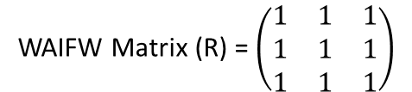
Full Release - First Group (i)
We model a full release of the entire population (i, j and k) after the vaccination of the first sub-population (i). This increases the R of the entire population from 1 to 1.8. This is 25% between 1 and the baseline of 4.2, representing a weaker NPI release.
Attack Rate for fully susceptible individuals in sub-group i (not previously exposed or vaccinated) = 0.0083
WAIFW Matrix (R) = $\left(\begin{matrix}1 & 1 & 1 \\ 1 & 1 & 1 \\ 1 & 1 & 1\end{matrix}\right)$
Before first vaccination schedule (t < 90)
WAIFW Matrix (R) = $\left(\begin{matrix}1.8 & 1.8 & 1.8 \\ 1.8 & 1.8 & 1.8 \\ 1.8 & 1.8 & 1.8\end{matrix}\right)$
After first vaccination schedule (t > 90)

Slide 6

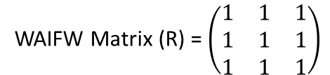
Full Release - Second Group (j)
We model a full release of the entire population (i, j and k) after the vaccination of the second sub-population (j). This increases the R of the entire population from 1 to 1.8. This is 25% between 1 and the baseline of 4.2, representing a weaker NPI release.
Attack Rate for fully susceptible individuals in sub-group i (not previously exposed or vaccinated) = 0.008
WAIFW Matrix (R) = $\left(\begin{matrix}1 & 1 & 1 \\ 1 & 1 & 1 \\ 1 & 1 & 1\end{matrix}\right)$
Before second vaccination schedule (t < 180)
WAIFW Matrix (R) = $\left(\begin{matrix}1.8 & 1.8 & 1.8 \\ 1.8 & 1.8 & 1.8 \\ 1.8 & 1.8 & 1.8\end{matrix}\right)$
After second vaccination schedule (t > 180)

Slide 7

Full Release - Third Group (k)
We model a full release of the entire population (i, j and k) after the vaccination of the last sub-population (k). This increases the R of the entire population from 1 to 1.8. This is 25% between 1 and the baseline of 4.2, representing a weaker NPI release.
Attack Rate for fully susceptible individuals in sub-group i (not previously exposed or vaccinated) = 0.008
WAIFW Matrix (R) = $\left(\begin{matrix}1 & 1 & 1 \\ 1 & 1 & 1 \\ 1 & 1 & 1\end{matrix}\right)$
Before final vaccination schedule (t < 270)
WAIFW Matrix (R) = $\left(\begin{matrix}1.8 & 1.8 & 1.8 \\ 1.8 & 1.8 & 1.8 \\ 1.8 & 1.8 & 1.8\end{matrix}\right)$
After final vaccination schedule (t > 270)

Slide 8
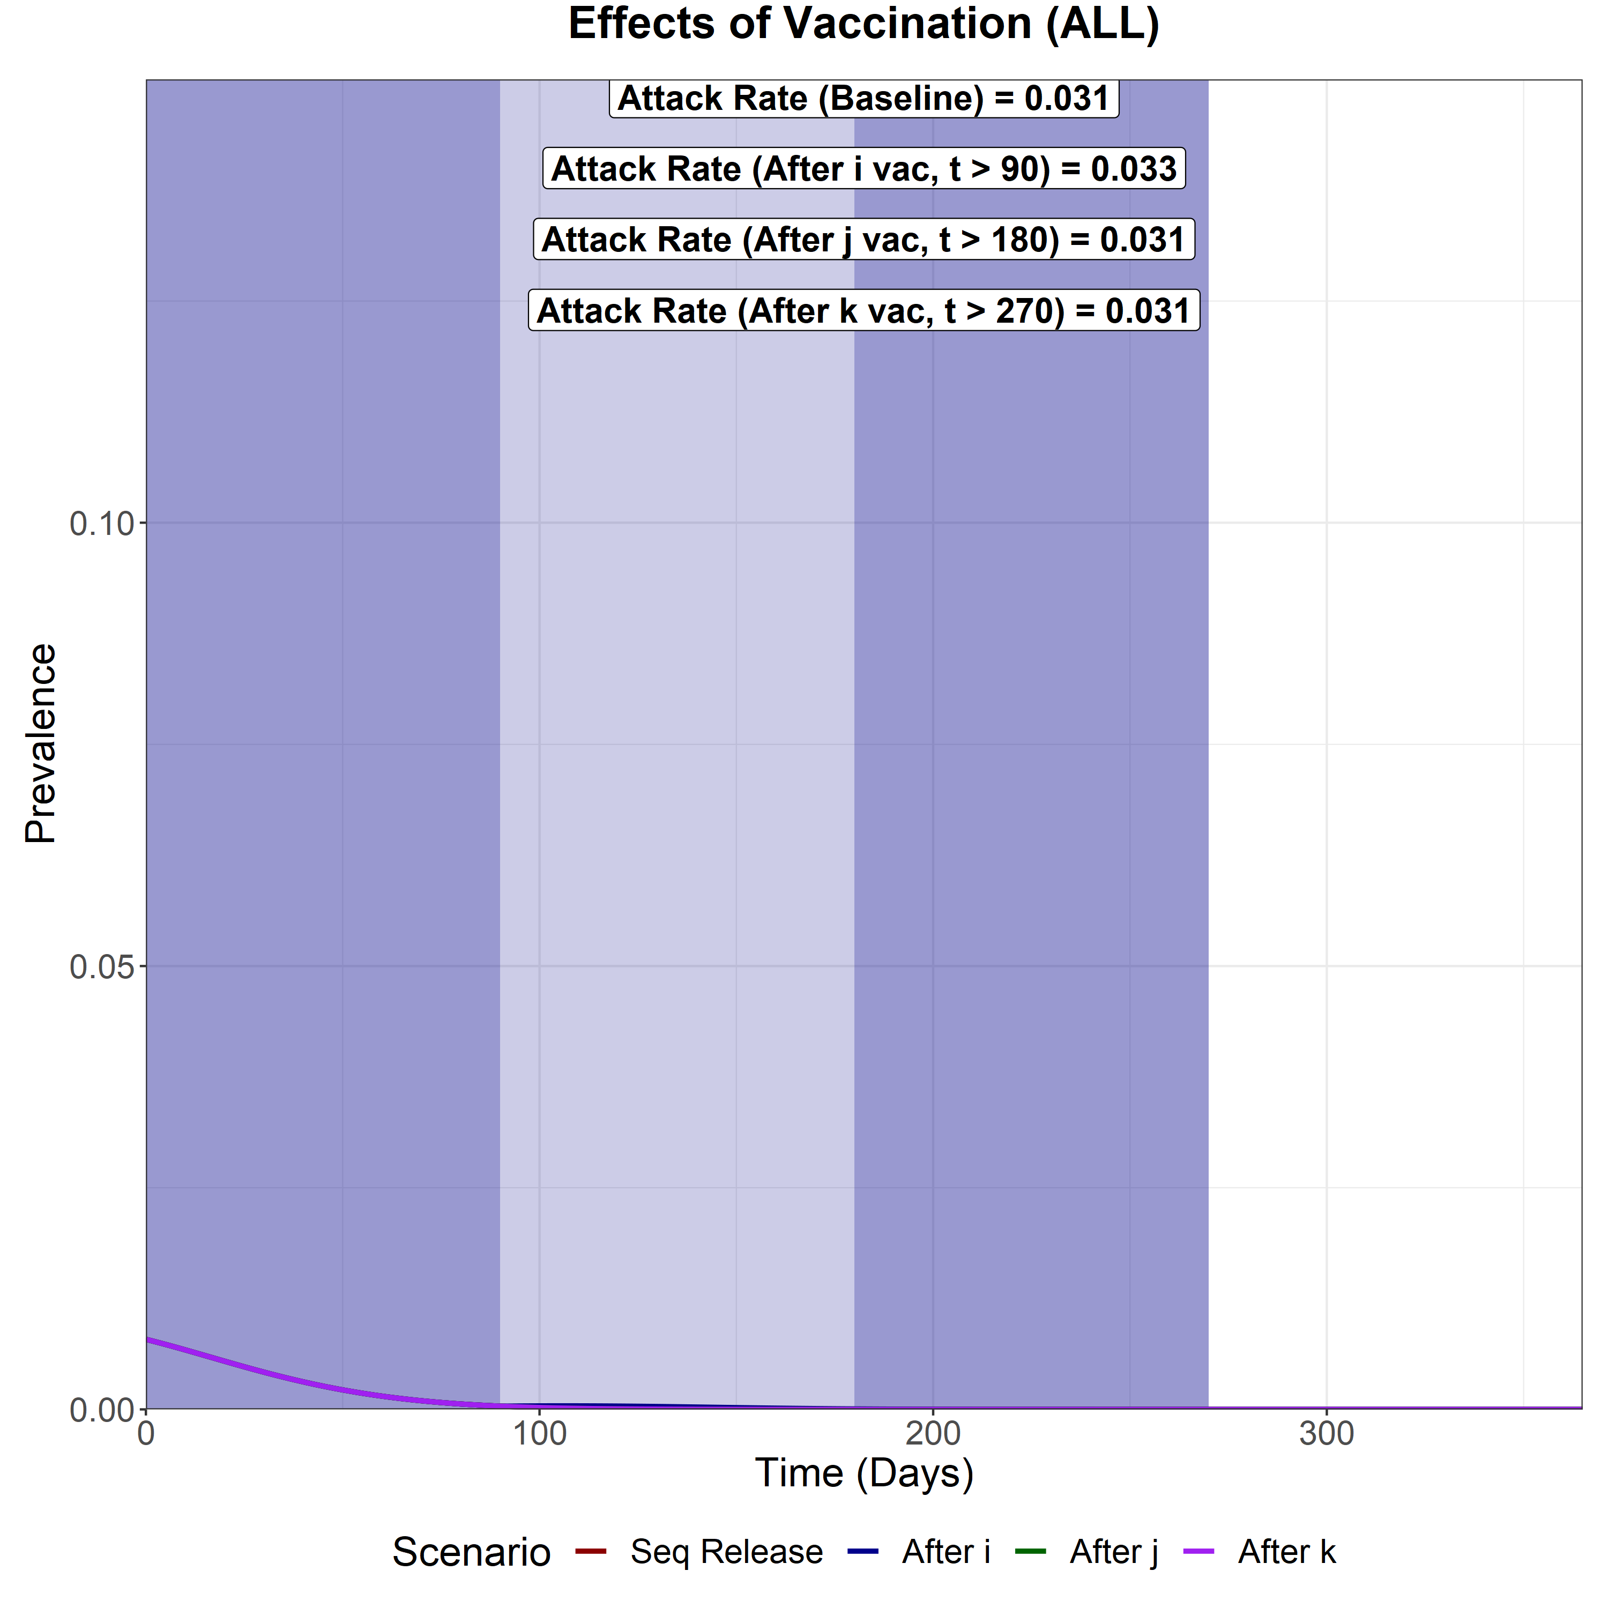
Scenario Analysis (Total Infected)
We now compare the total epidemic curve (the sum of the infectious compartment in each subpopulation) for 4 different scenarios:
With vaccination and sequential intervention release
Full release after vaccination of the first subpopulation (i)
Full release after vaccination of the second subpopulation (j)
Full release after vaccination of the last subpopulation (k)
The three shaded areas are the vaccination periods for subpopulation i, j and k respectively.
Sequential Vaccination
Attack Rate (i) – 0.009
Attack Rate (j) – 0.011
Attack Rate (k) – 0.011
Attack Rate for fully susceptible individuals in sub-group i = 0.0082
Full Release after vaccination of i
Attack Rate (i) – 0.009
Attack Rate (j) – 0.012
Attack Rate (k) – 0.013
Attack Rate for fully susceptible individuals in sub-group i = 0.0083
Full Release after vaccination of j
Attack Rate (i) – 0.009
Attack Rate (j) – 0.011
Attack Rate (k) – 0.011
Attack Rate for fully susceptible individuals in sub-group i = 0.008
Full Release after vaccination of k
Attack Rate (i) – 0.009
Attack Rate (j) – 0.011
Attack Rate (k) – 0.011
Attack Rate for fully susceptible individuals in sub-group i = 0.008

Slide 9
SENSITIVITY TO VACCINE COVERAGE
We model varying levels of vaccine coverage. Coverage is varied from 90% (baseline), 70% to 50%.

Slide 10
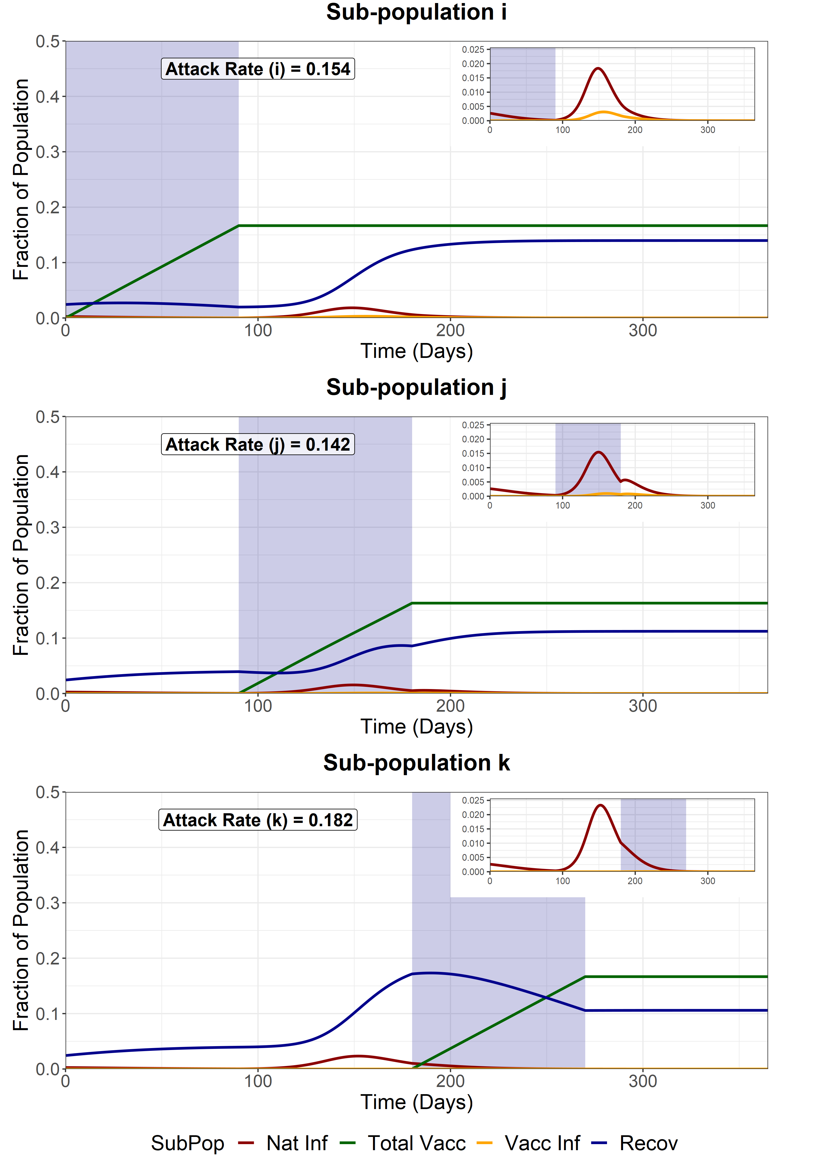
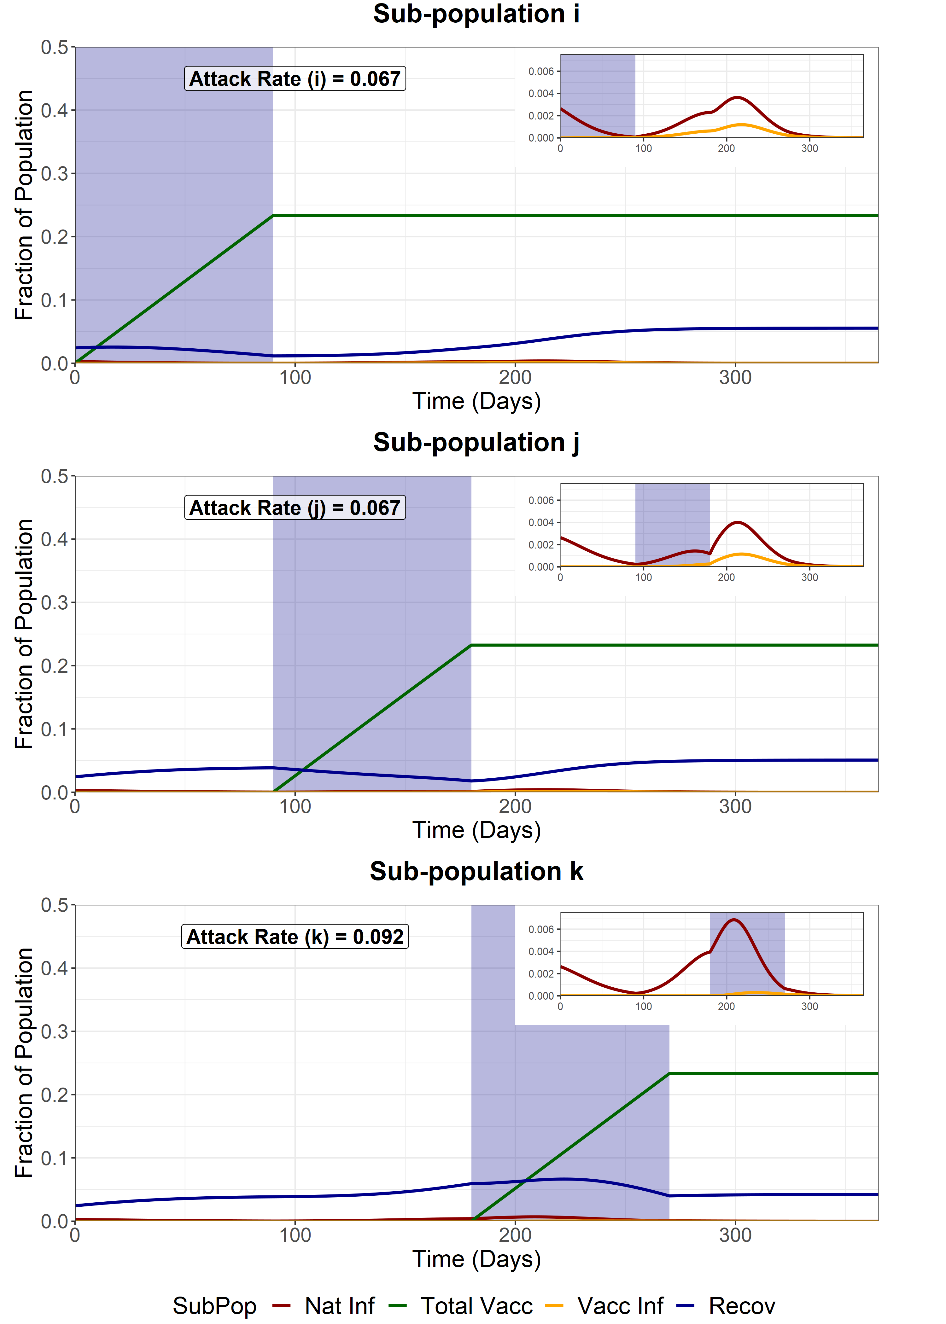

Sequential Vaccination
We model sequential vaccination of 3 sub-populations. Each vaccination schedule lasts 90 days and aims for a variable coverage of the available susceptibles, infecteds and recovereds at the beginning of the simulation. After vaccination of each subpopulation, the sub-population is released from NPIs, with the R increasing from 1 to 4.2. WAIFW matrix changes are the same as the baseline scenarios.
Vaccine Coverage = 50%
Vaccine Coverage = 70%
Vaccine Coverage = 90%
Attack Rate for fully susceptible individuals in sub-group i = 0.131
Attack Rate for fully susceptible individuals in sub-group i = 0.053
Attack Rate for fully susceptible individuals in sub-group i = 0.0084

Slide 11
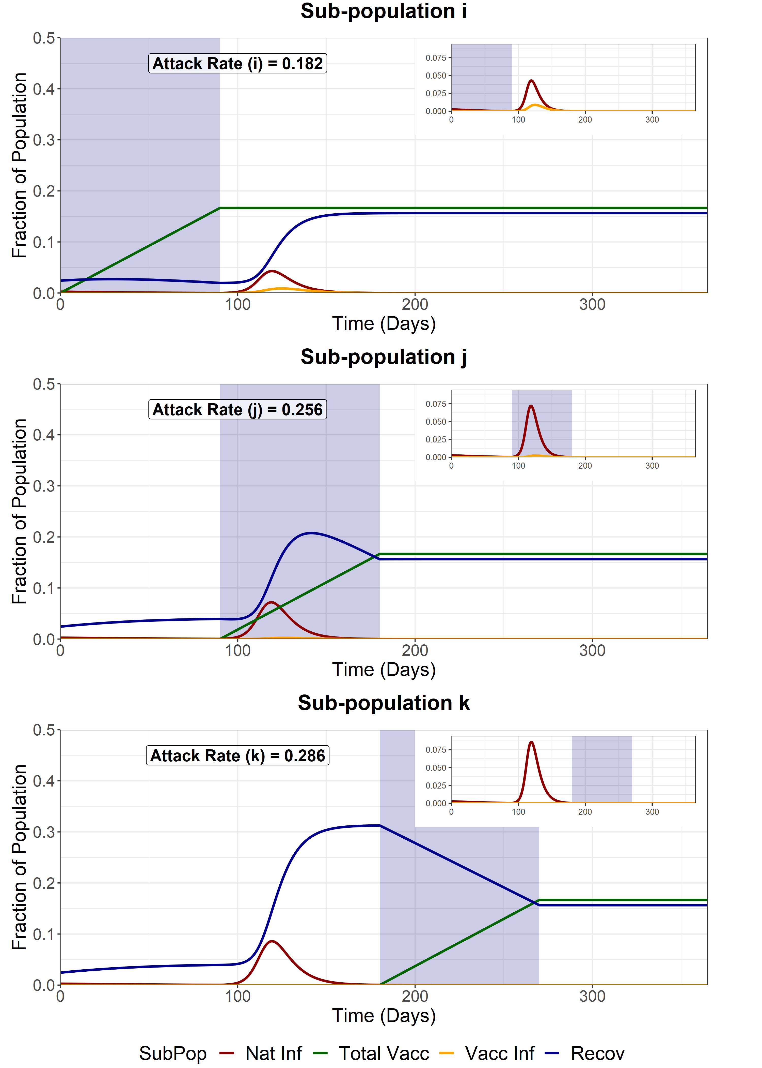
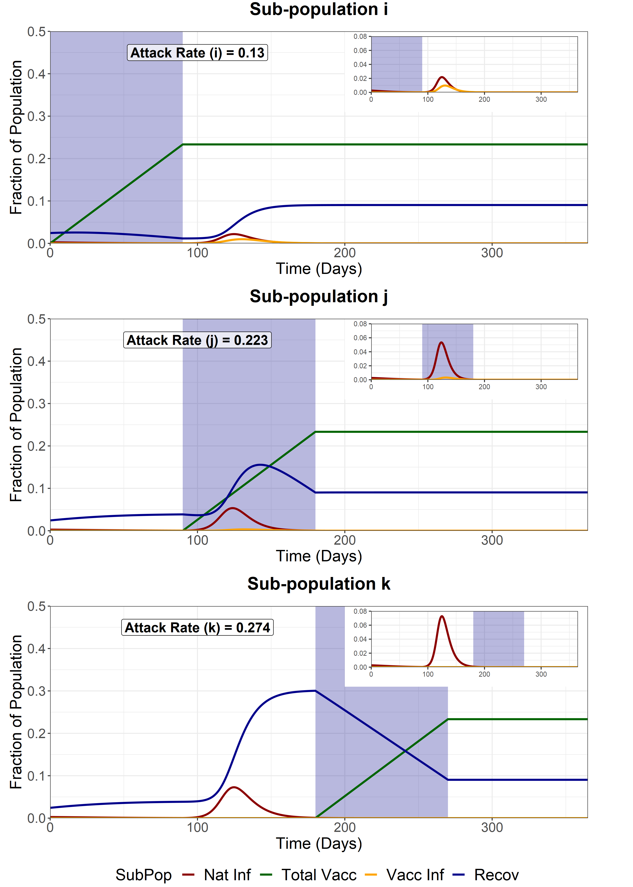
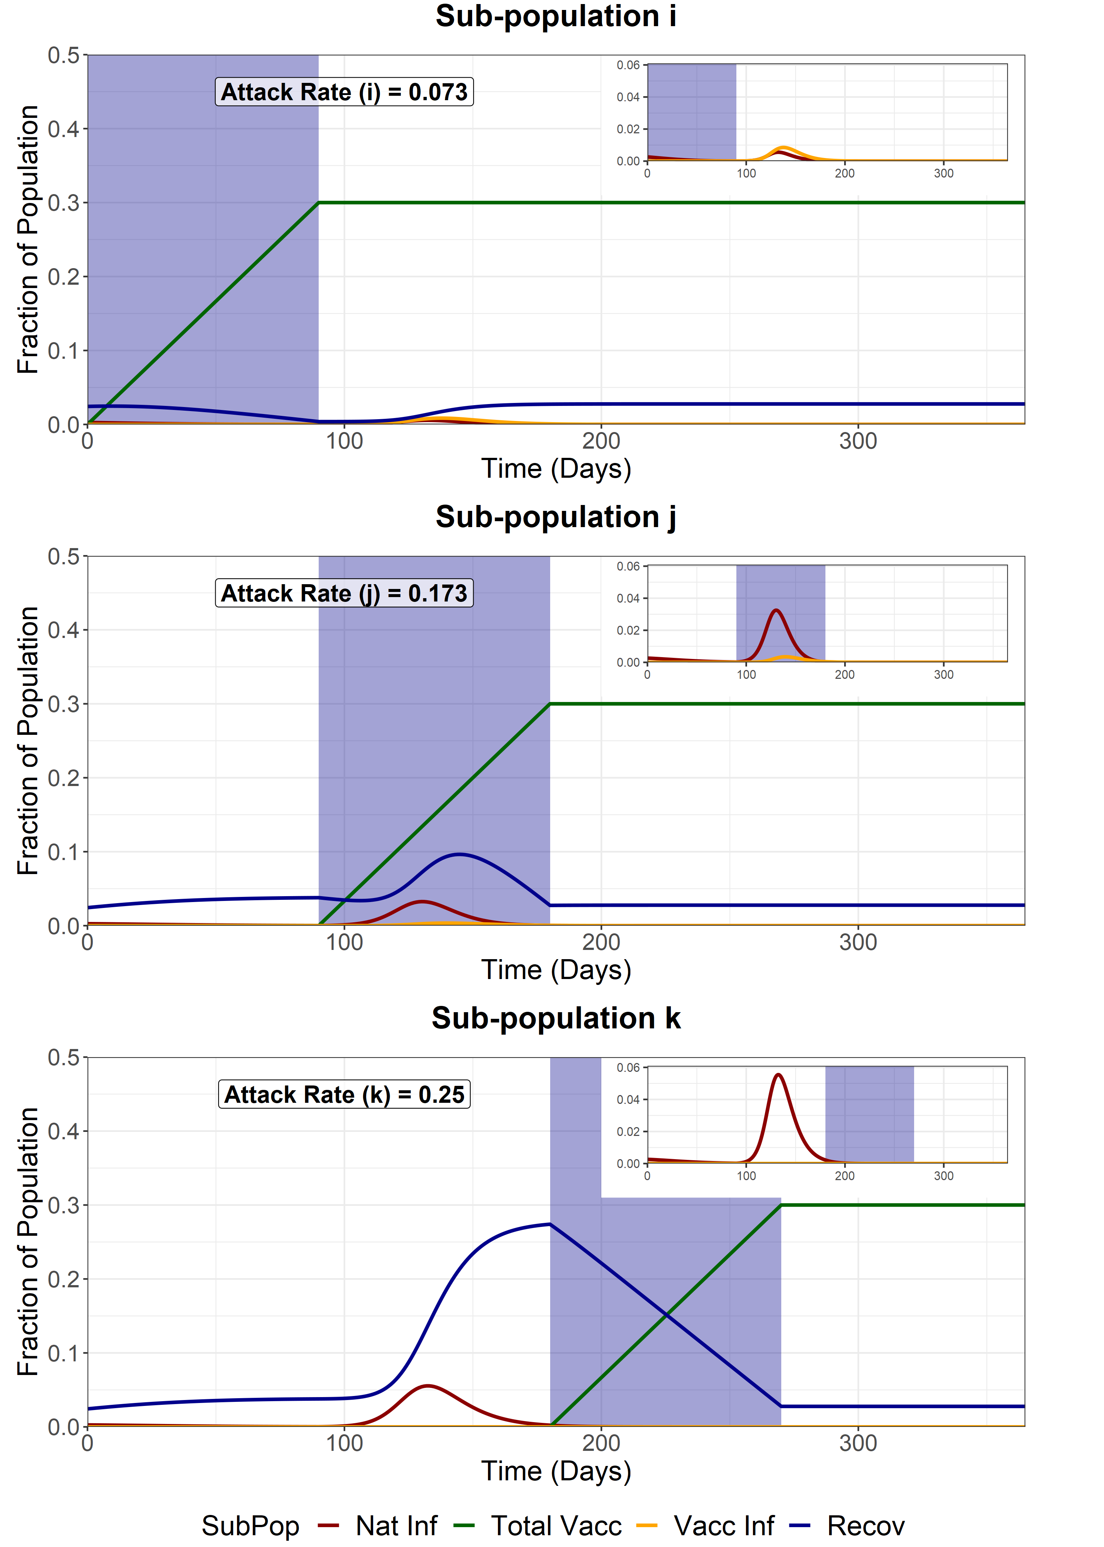
Full Release - First Group (i)
We model a full release of the entire population (i, j and k) after the vaccination of the first sub-population (i). This increases the R of the entire population from 1 to 4.2. WAIFW matrix changes are the same as the baseline scenarios.
Vaccine Coverage = 50%
Vaccine Coverage = 70%
Vaccine Coverage = 90%
Attack Rate for fully susceptible individuals in sub-group i = 0.147
Attack Rate for fully susceptible individuals in sub-group i = 0.088
Attack Rate for fully susceptible individuals in sub-group i = 0.032

Slide 12
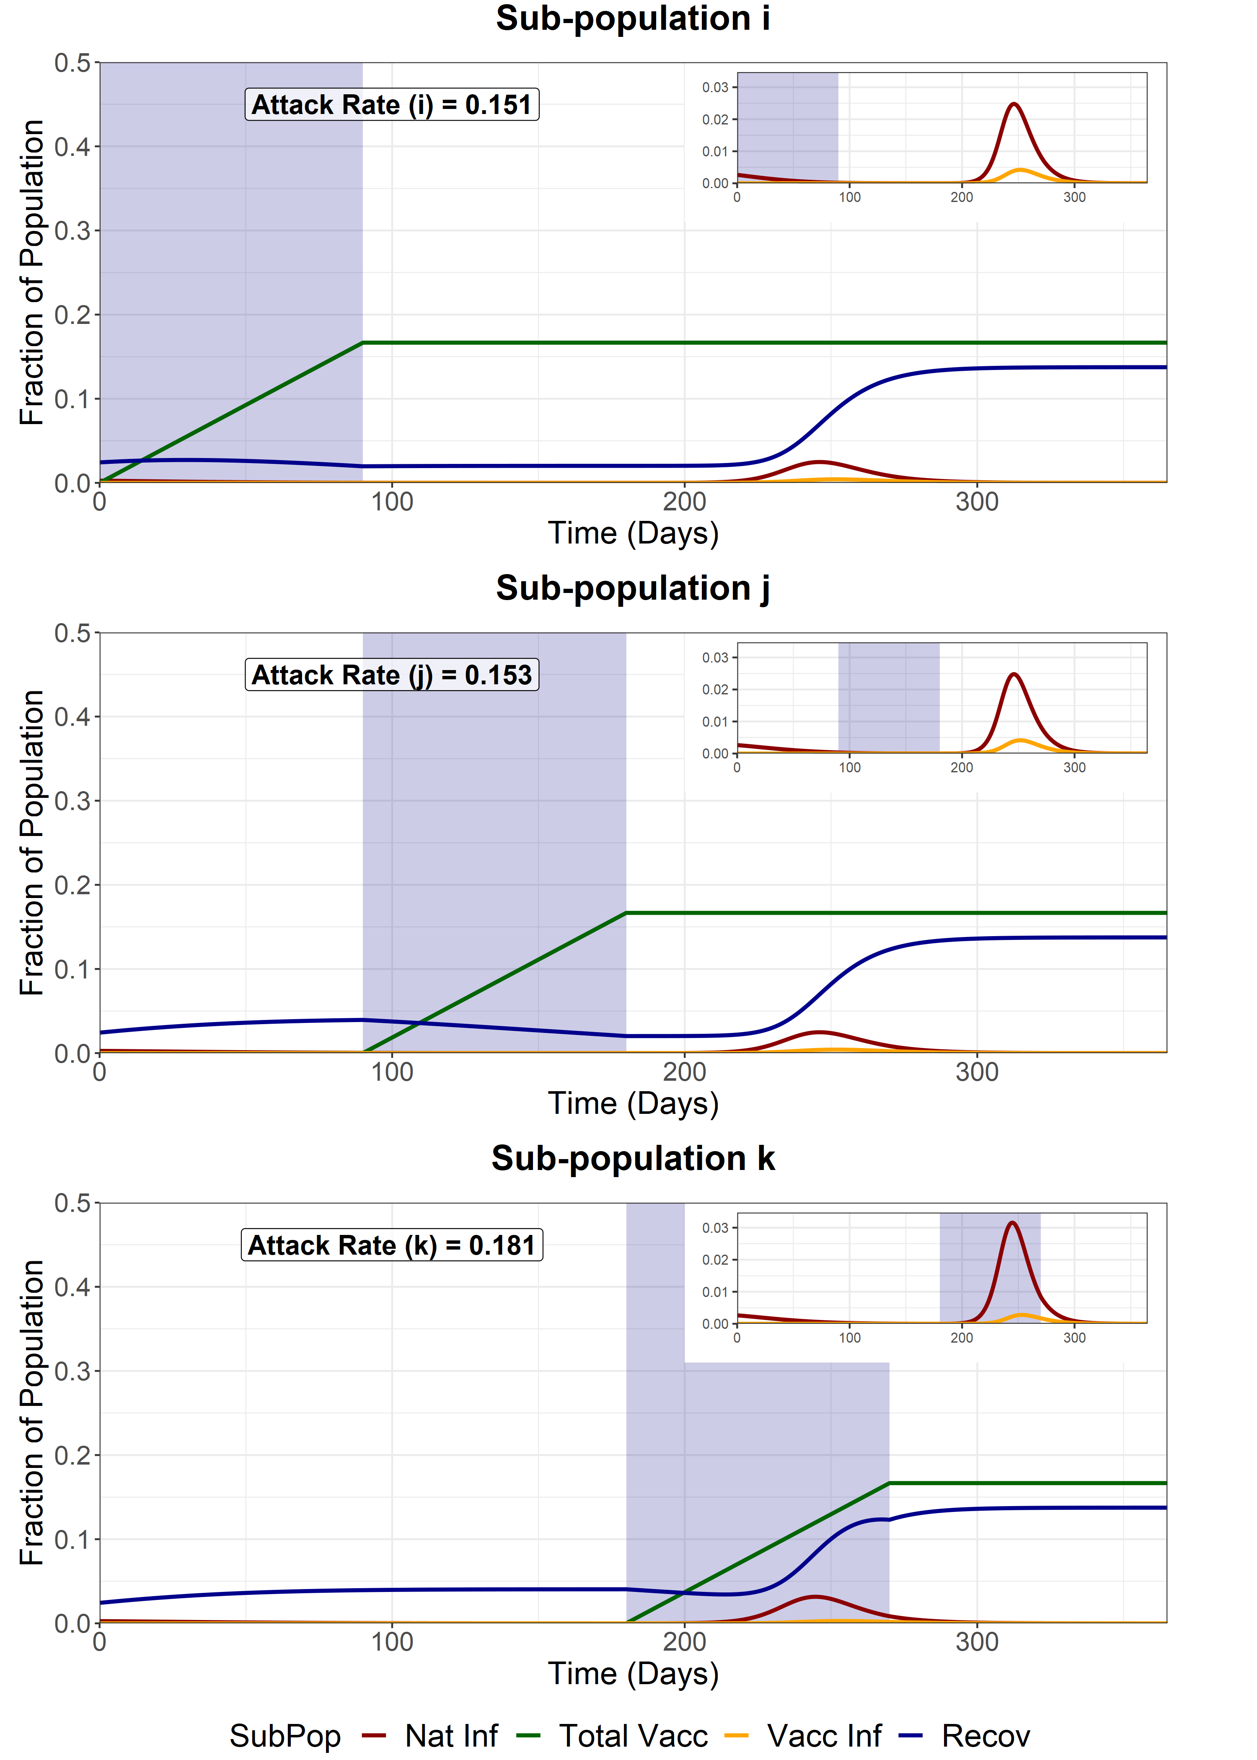
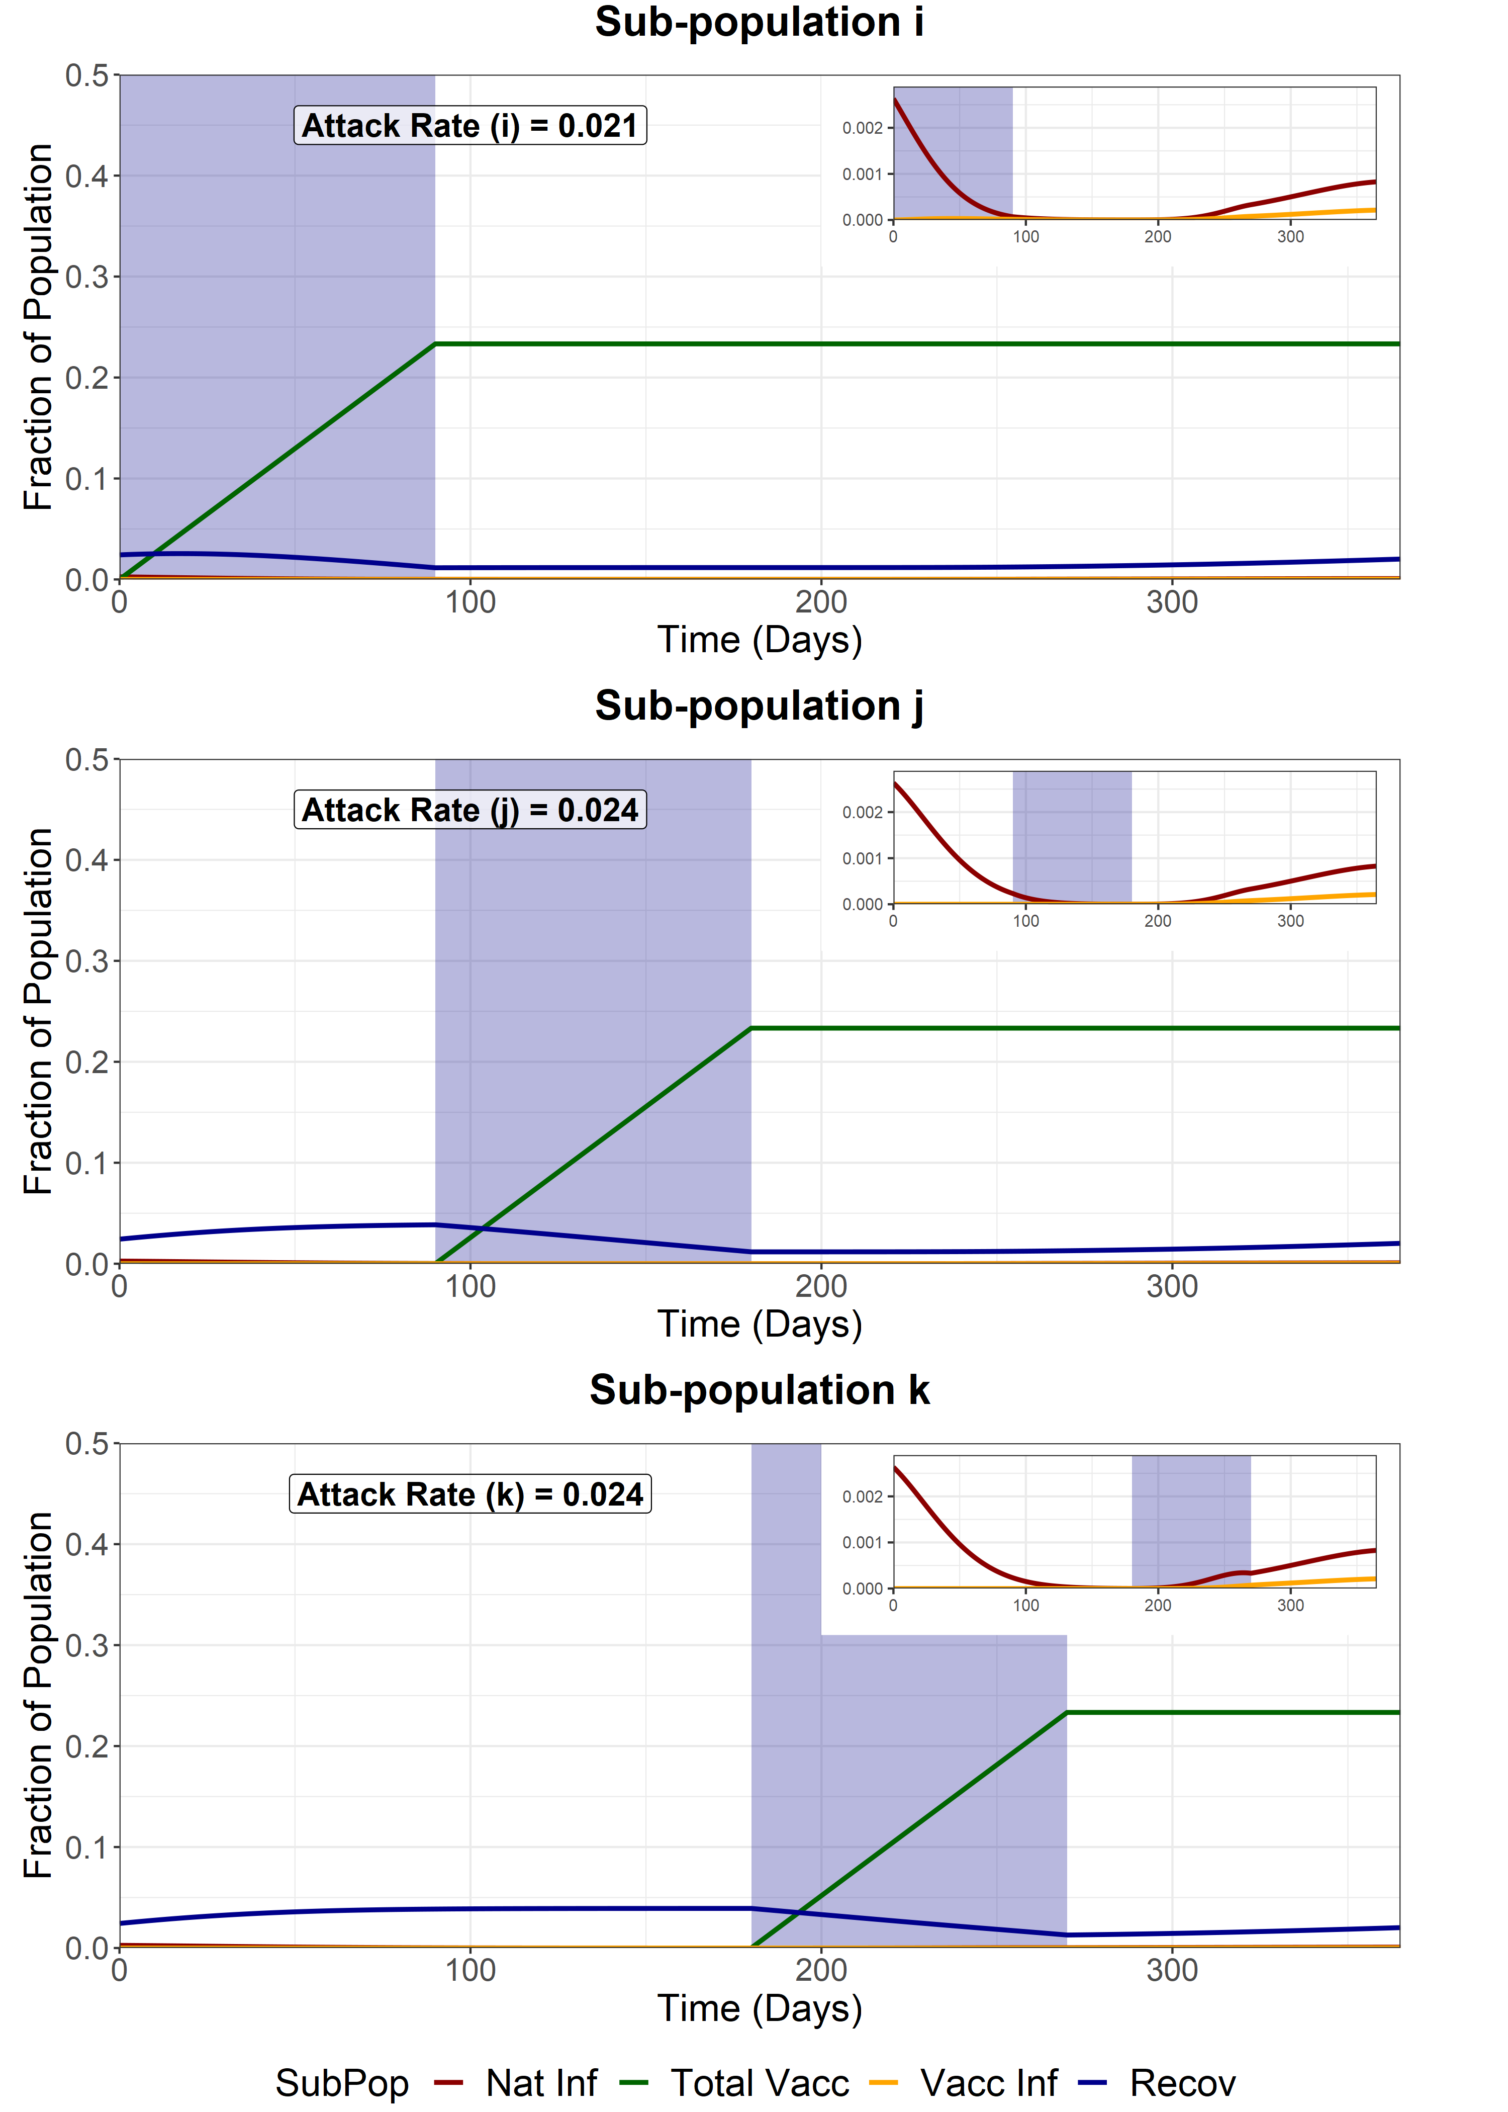

Full Release - Second Group (j)
We model a full release of the entire population (i, j and k) after the vaccination of the second sub-population (j). This increases the R of the entire population from 1 to 4.2. WAIFW matrix changes are the same as the baseline scenarios.
Vaccine Coverage = 50%
Vaccine Coverage = 70%
Vaccine Coverage = 90%
Attack Rate for fully susceptible individuals in sub-group i = 0.128
Attack Rate for fully susceptible individuals in sub-group i = 0.0186
Attack Rate for fully susceptible individuals in sub-group i = 0.008

Slide 13
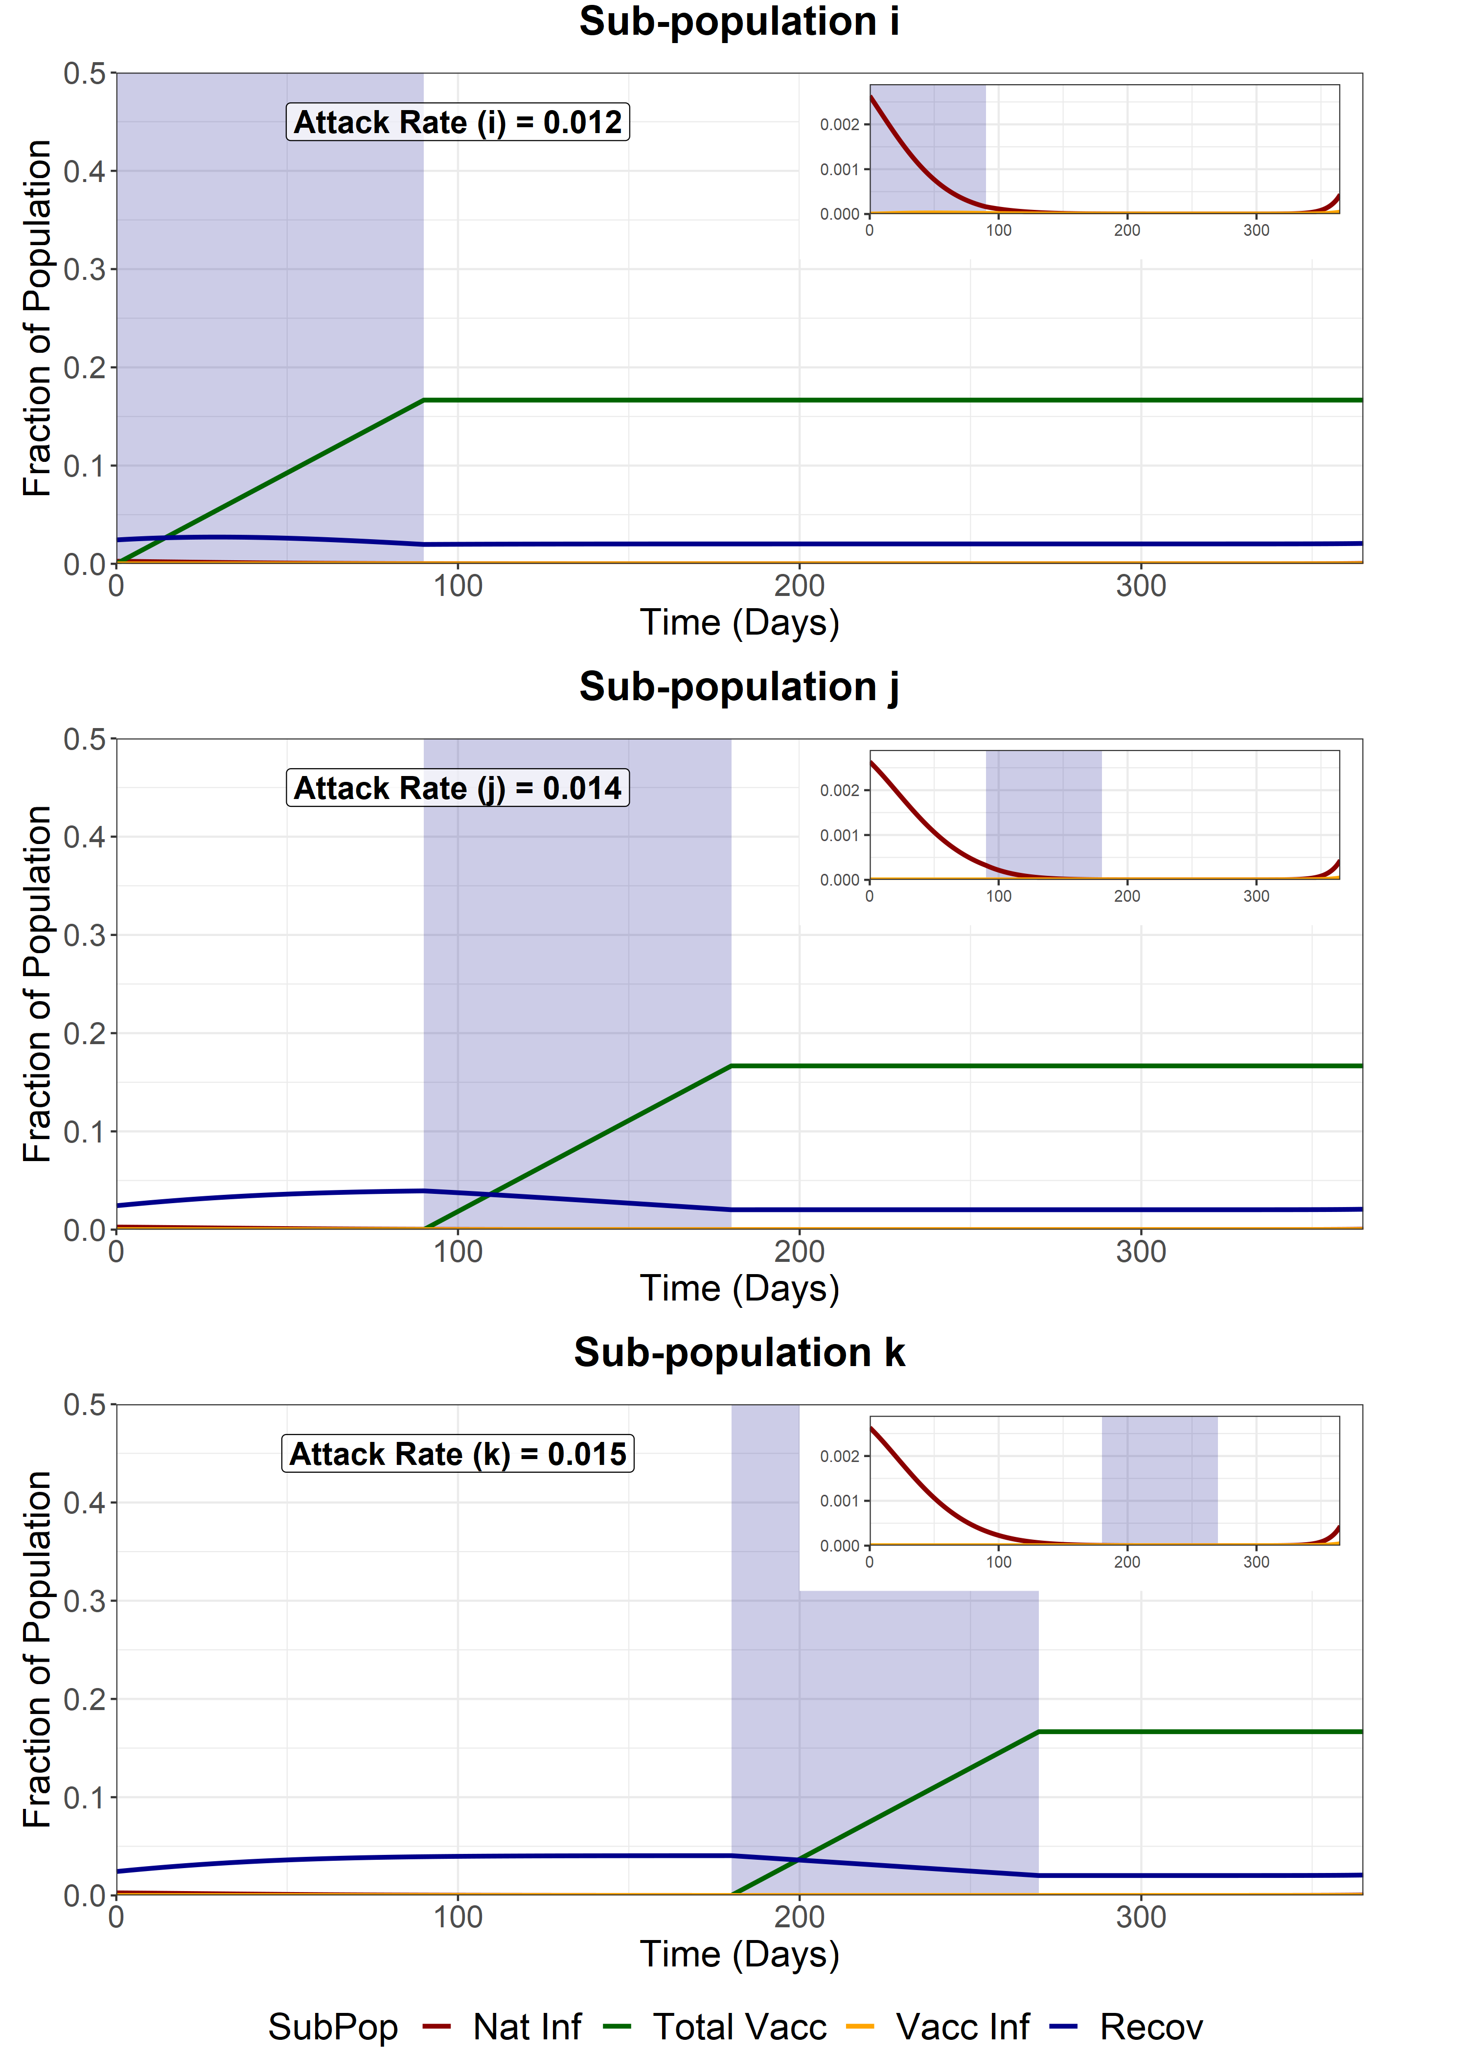
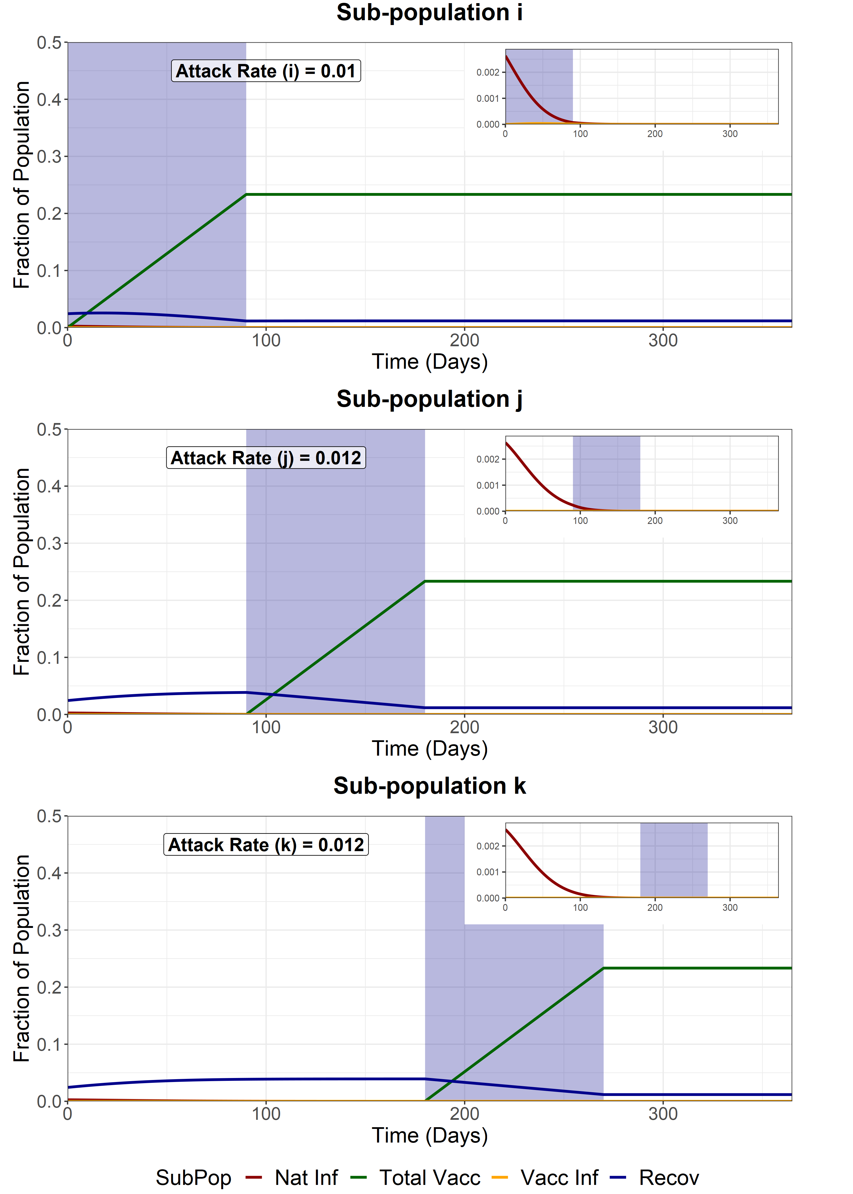

Full Release - Third Group (k)
We model a full release of the entire population (i, j and k) after the vaccination of the last sub-population (k). This increases the R of the entire population from 1 to 4.2. WAIFW matrix changes are the same as the baseline scenarios.
Vaccine Coverage = 50%
Vaccine Coverage = 70%
Vaccine Coverage = 90%
Attack Rate for fully susceptible individuals in sub-group i = 0.0120
Attack Rate for fully susceptible individuals in sub-group i = 0.0094
Attack Rate for fully susceptible individuals in sub-group i = 0.008

Slide 14
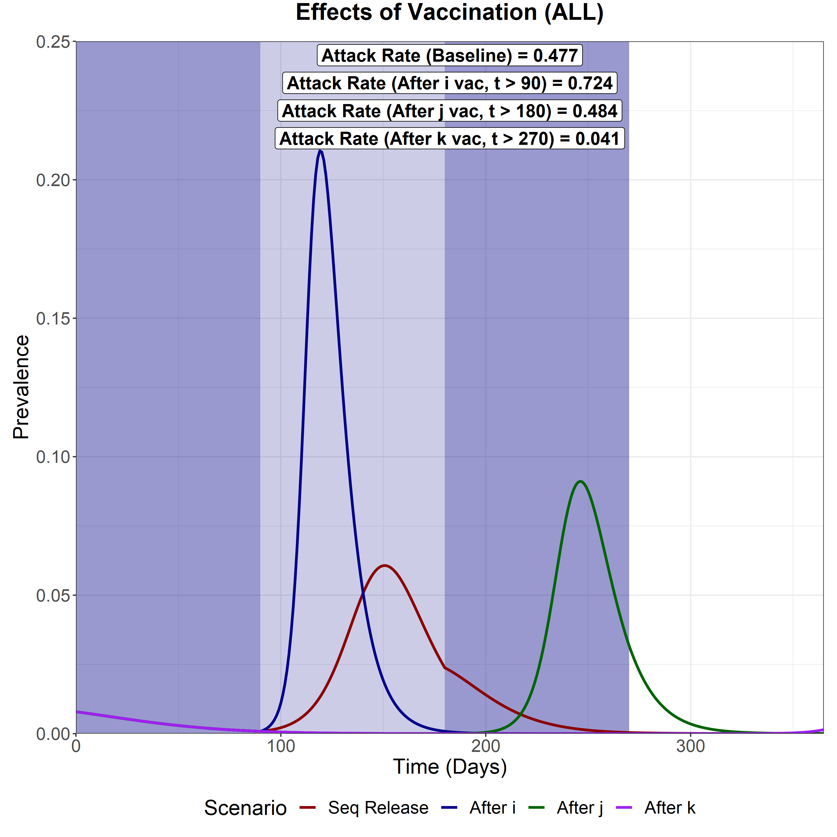
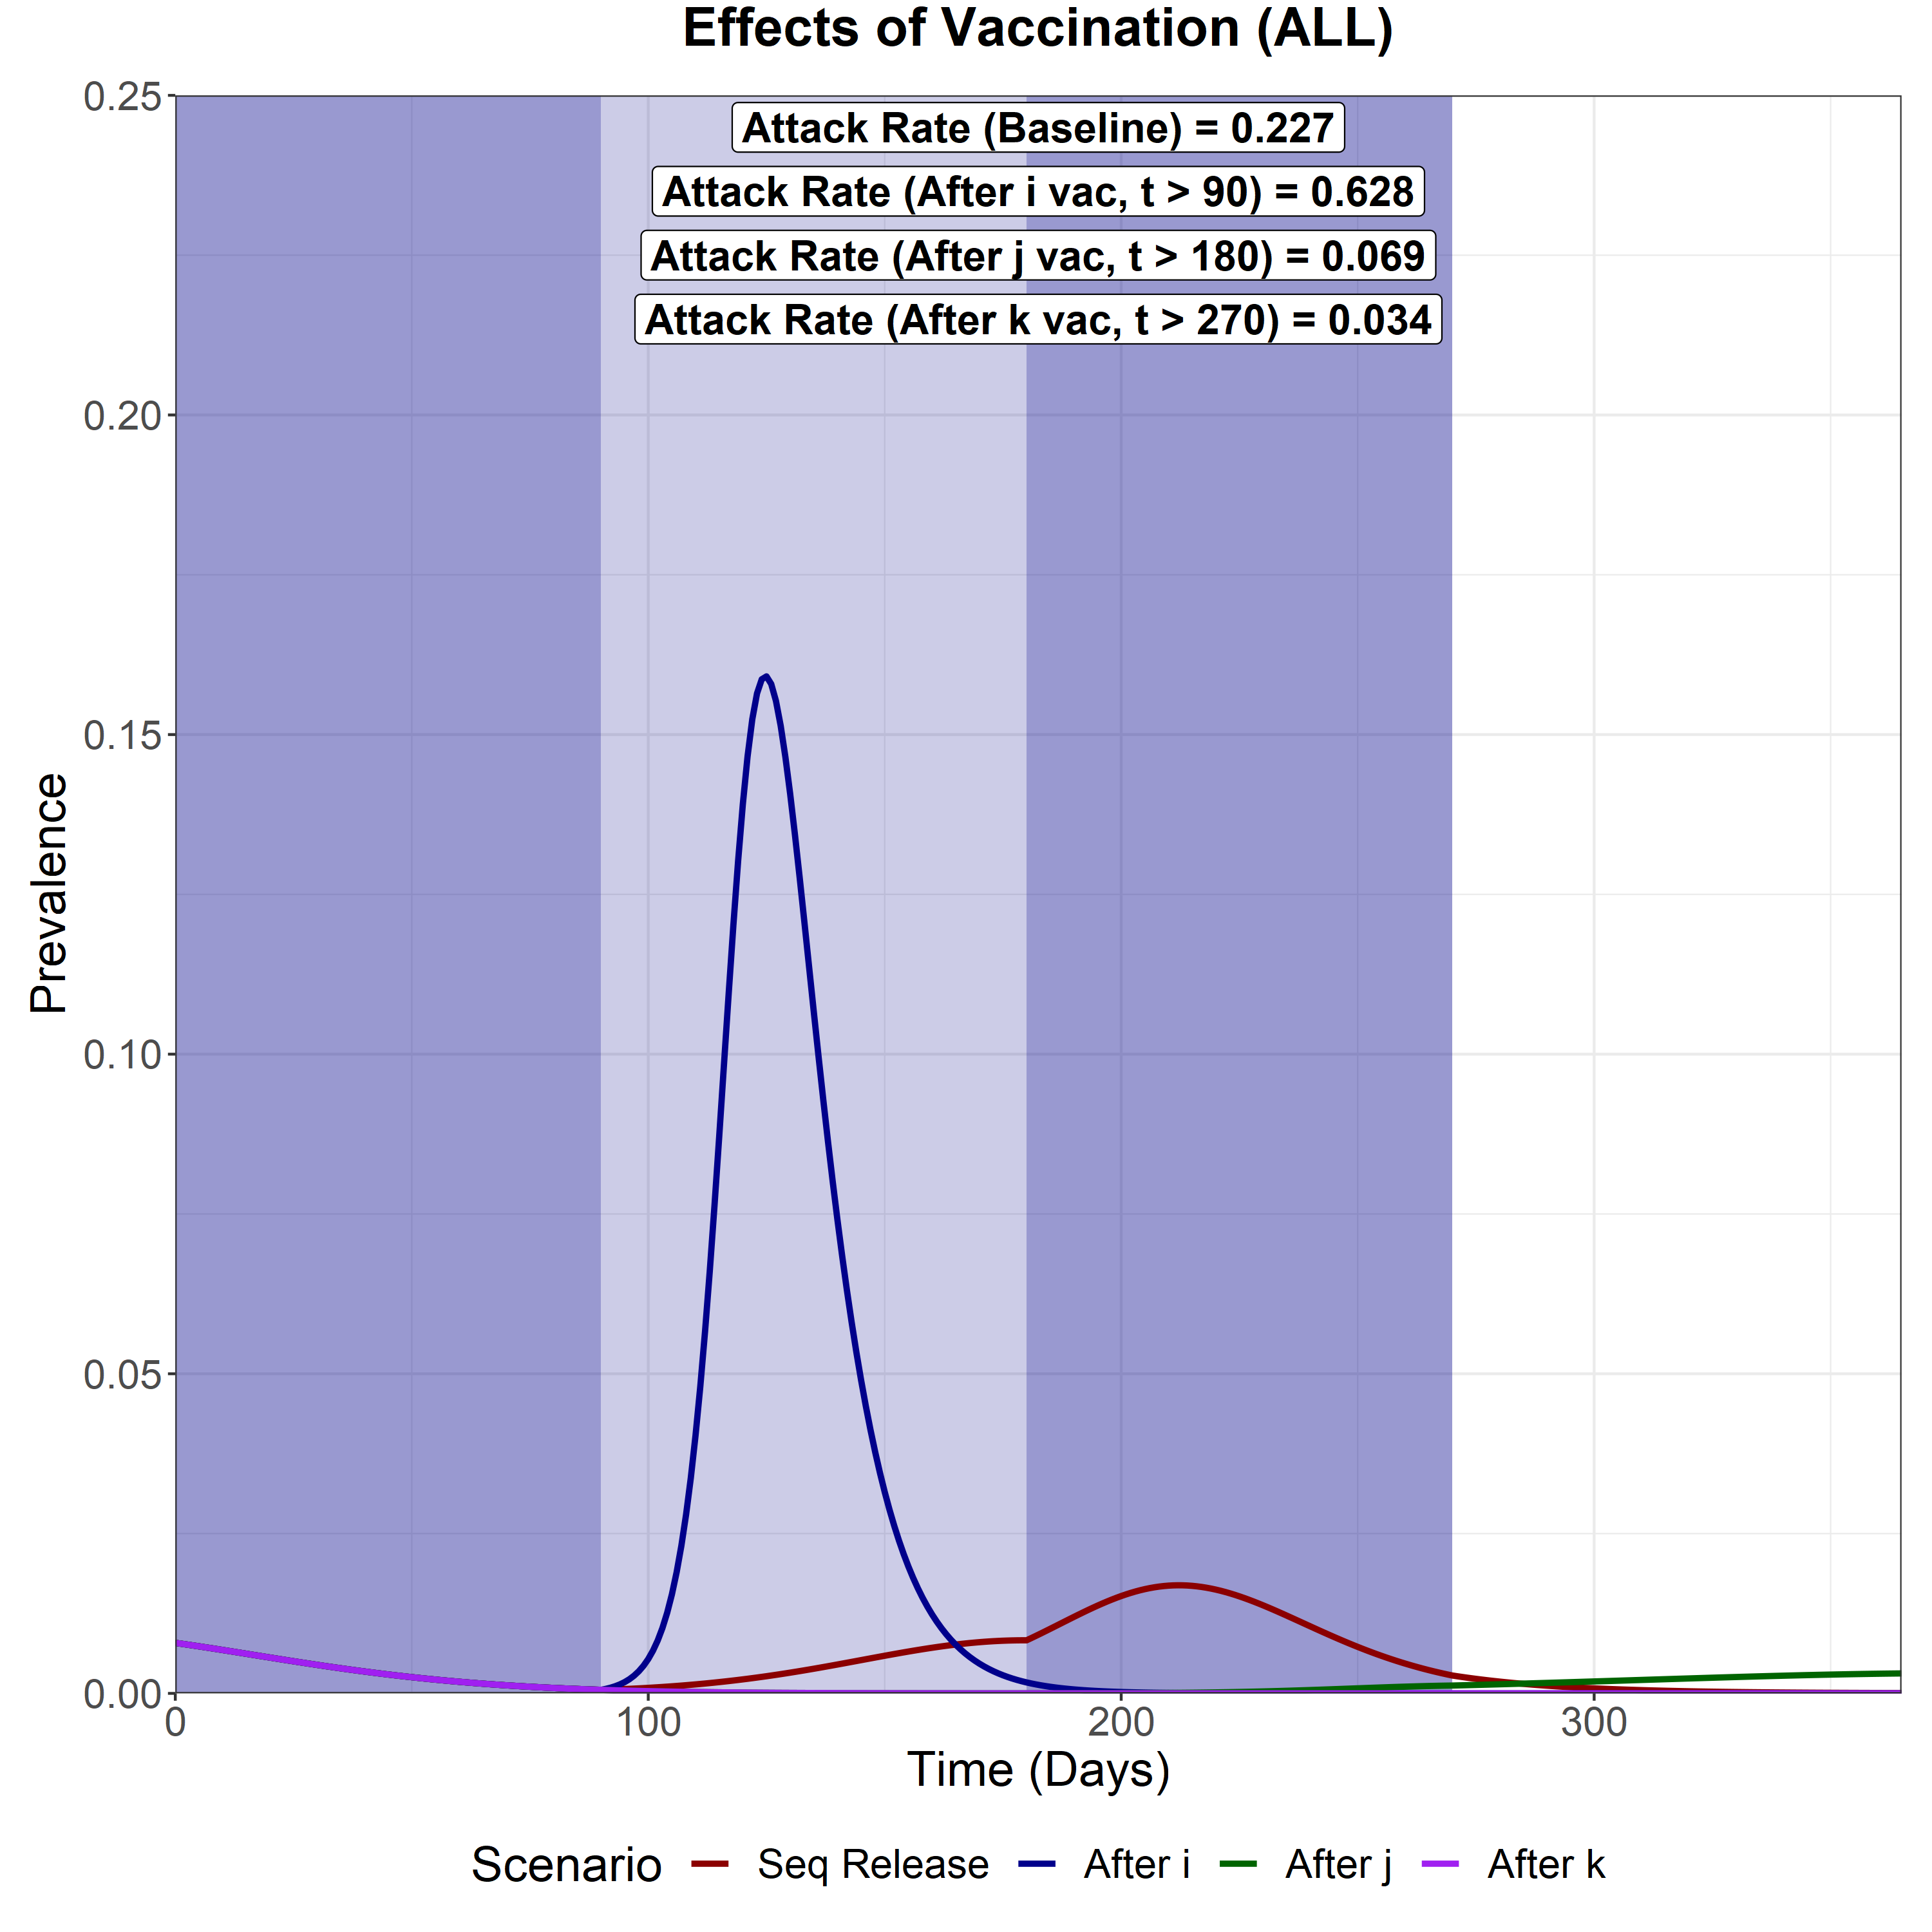
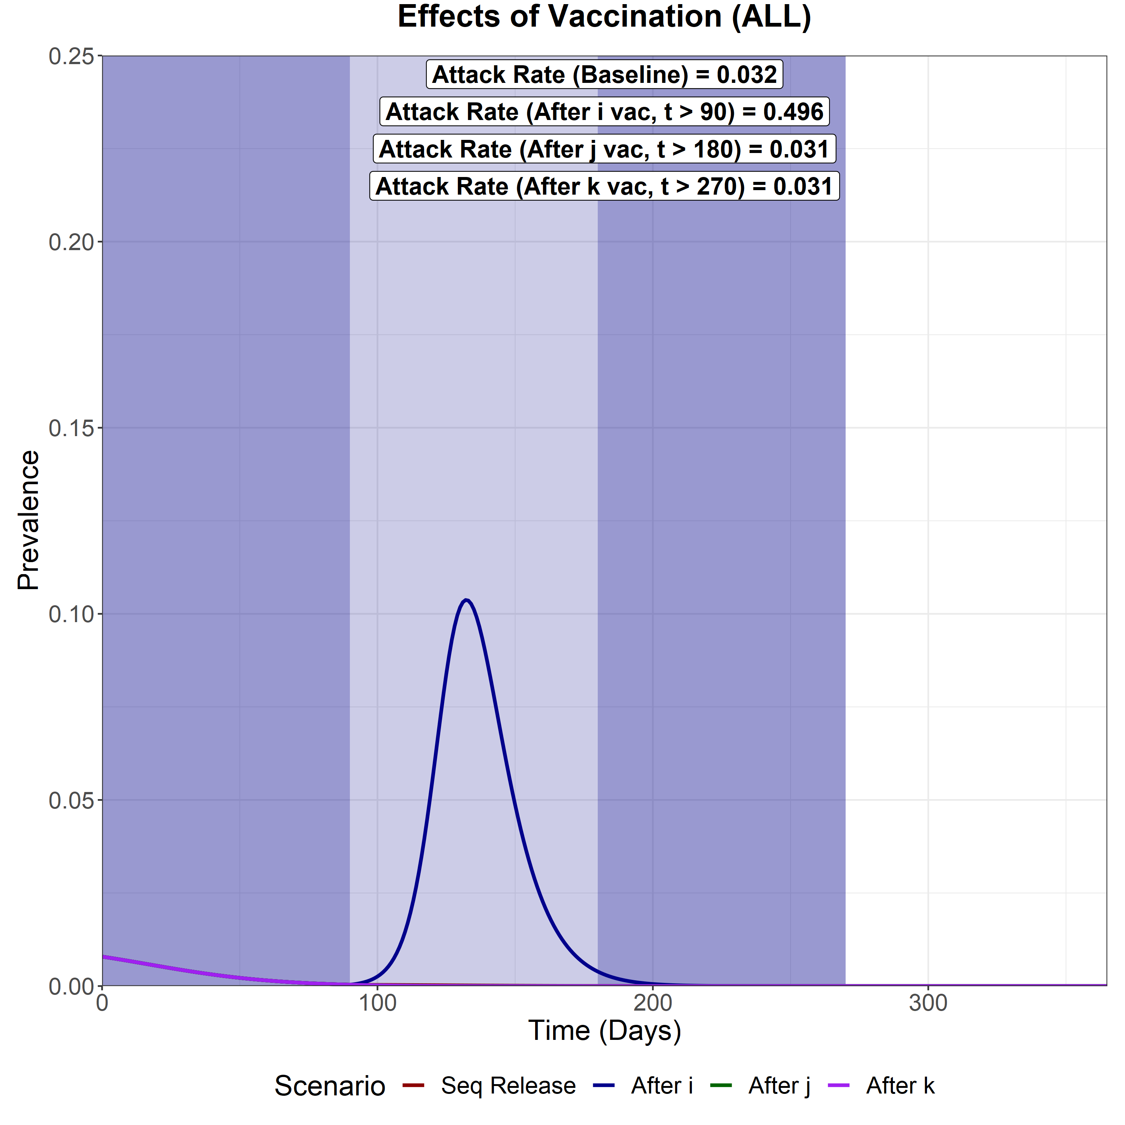
Vaccine Coverage = 50%
Vaccine Coverage = 70%
Vaccine Coverage = 90%
Sequential Vaccination
Attack Rate (i) – 0.154
Attack Rate (j) – 0.142
Attack Rate (k) – 0.182
Attack Rate for fully susceptibles in i - 0.131
Full Release after i vacc
Attack Rate (i) – 0.182
Attack Rate (j) – 0.256
Attack Rate (k) – 0.286
Attack Rate for fully susceptibles in i - 0.147
Full Release after j vacc
Attack Rate (i) – 0.151
Attack Rate (j) – 0.153
Attack Rate (k) – 0.181
Attack Rate for fully susceptibles in i - 0.128
Full Release after k vacc
Attack Rate (i) – 0.012
Attack Rate (j) – 0.014
Attack Rate (k) – 0.015
Attack Rate for fully susceptibles in i - 0.0120
Sequential Vaccination
Attack Rate (i) – 0.067
Attack Rate (j) – 0.067
Attack Rate (k) – 0.092
Attack Rate for fully susceptibles in i - 0.053
Full Release after i vacc
Attack Rate (i) – 0.13
Attack Rate (j) – 0.223
Attack Rate (k) – 0.274
Attack Rate for fully susceptibles in i - 0.088
Full Release after j vacc
Attack Rate (i) – 0.021
Attack Rate (j) – 0.024
Attack Rate (k) – 0.024
Attack Rate for fully susceptibles in i - 0.0186
Full Release after k vacc
Attack Rate (i) – 0.01
Attack Rate (j) – 0.012
Attack Rate (k) – 0.012
Attack Rate for fully susceptibles in i - 0.0094
Sequential Vaccination
Attack Rate (i) – 0.009
Attack Rate (j) – 0.012
Attack Rate (k) – 0.012
Attack Rate for fully susceptibles in i - 0.0084
Full Release after i vacc
Attack Rate (i) – 0.073
Attack Rate (j) – 0.173
Attack Rate (k) – 0.25
Attack Rate for fully susceptibles in i - 0.032
Full Release after j vacc
Attack Rate (i) – 0.008
Attack Rate (j) – 0.011
Attack Rate (k) – 0.011
Attack Rate for fully susceptibles in i - 0.008
Full Release after k vacc
Attack Rate (i) – 0.009
Attack Rate (j) – 0.011
Attack Rate (k) – 0.011
Attack Rate for fully susceptibles in i - 0.008

